Slide 2

Transistor
Transistor was first invented in 1948 by William Shockley, John Bardeen and Walter Brattain of Bell Laboratories, which was commercially used in the telephone circuits in 1951.
A Bipolar Junction Transistor (BJT) is a three terminal semiconductor device in which the operation depends on the interaction of both majority and minority carriers and hence the name bipolar.
It is a two junction semiconductor
It is an active component
Transistor=Transfer + Resistor

Slide 3
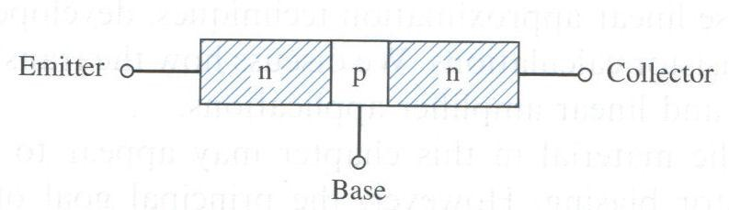
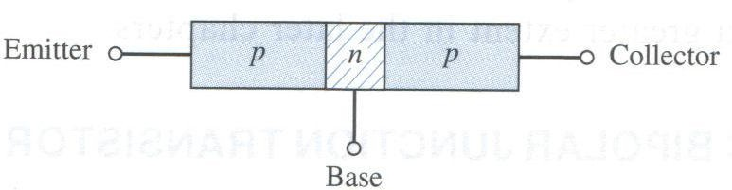
Transistor Structures
The bipolar junction transistor (BJT) has three separately doped regions and contains two p-n junctions.
Bipolar transistor is a 3-terminal device.
Emitter (E)
Base (B)
Collector (C)
The basic transistor principle is that the voltage between two terminals controls the current through the third terminal.
Current in the transistor is due to the flow of both electrons and holes, hence the name bipolar.

Slide 4
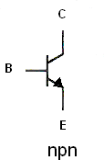
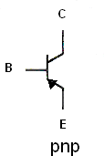
Transistor Structures
There are two types of bipolar junction transistor: npn and pnp.
The npn bipolar transistor contains a thin p-region between two n-regions.
The pnp bipolar transistor contains a thin n-region sandwiched between two p- regions.

Slide 5
Other Points to Remember
Area of collector is always larger compared to emitter and base.
The base region is made very thin to increase the concentration gradient and hence the higher diffusion rate.
Doping of base region is also less compared to emitter and collector.
Generally Emitter region is heavily doped so that more numbers of carriers are available for injection into the base region.
Purpose of using lightly doped Base is to reduce recombination .
There are two P-N junction present in BJT called Base-Emitter junction and Base-collector junction. Working of BJT entirely depends upon properties and biasing of those junctions.

Slide 6
A bipolar junction transistor (BJT) is a three terminal device consisting of either two n-type and one p-type or two p-type and one n-type sandwiched between them.
Emitter is heavily doped, base is lightly doped and collector is very lightly doped.
The middle layer is lightly doped compared to outer layer typically (10:1) or low, to reduce conductivity in base.
The middle layer is known as base (B) and thin in size as compared to two outer layers, emitter(E) and collector(C). (C > E > B)
The ratio of total width to that center layer (base) is 150:1.
In BJT current depends on the both majority and minority carriers and hence the name bipolar.

Slide 7
Applications
It is used as amplifier and oscillator circuits and as a switch in digital circuits.
It has wide applications in computers, satellites and other modern communication systems.
The transistor's ability to change between these two states enables it to have two basic functions: "switching" (digital electronics) or "amplification" (analogue electronics).
Bipolar Transistors are current regulating devices that control the amount of current flowing through them in proportion to the amount of biasing voltage applied to their base terminal.

Slide 8
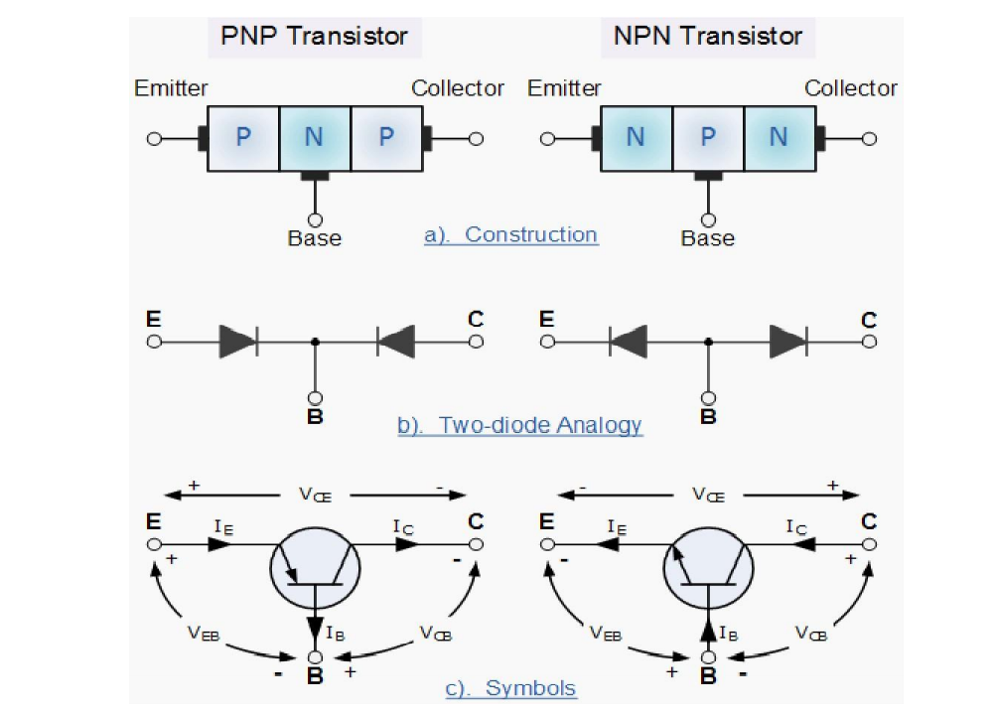

Slide 9

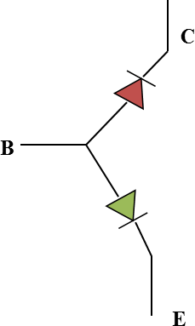
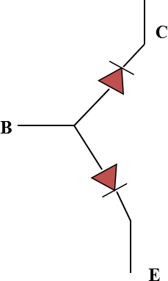
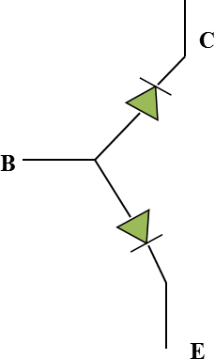
Operating Region
Active Region
Base-Emitter Junction forward biased. Collector-Base Junction reverse biased
Cutoff Region
The BJT is basically off. There is voltage but little current (leakage current).
Both junctions reverse biased
Saturation Region
Both junctions forward biased
Note: In Active and saturation region, BJT is ON and in cut-off region BJT is OFF. So BJT is
on when base-emitter junction is forward biased.
Active region used for design of BJT amplifier whereas saturation and cut-off region used in switching application of BJT.

Slide 10
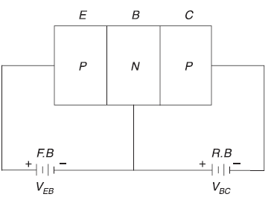
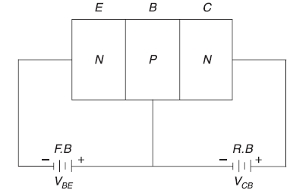
BJT Operation
The emitter-base junction is forward biased
The base-collector junction is reverse biased

Slide 11
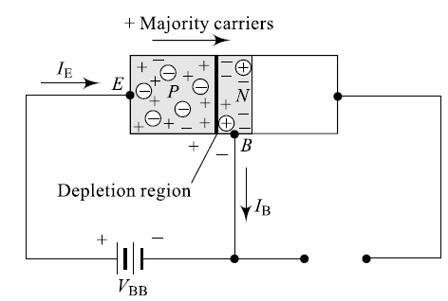
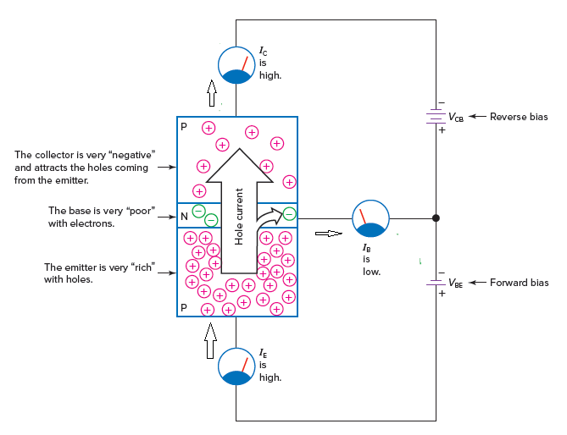
Operation of a PNP BJT
PNP with forward bias of Emitter-base junction:
Due to the forward bias, the depletion region get reduced that causes heavy flow of majority charge carrier from P-side to N-side
In P-region the majority carriers are holes
The sandwiched n-type material is very thin and low conductivity, a small number of charge carrier will flow through the base terminal. Hence, the base current is very small, typically in the order of microampere.

Slide 12
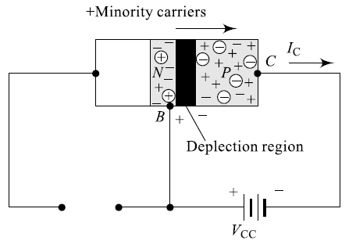
PNP with reverse bias of base-collector junction:
The applied base-emitter junction voltage is much smaller than the base-collector junction voltage.
In N-region majority charge carriers are electron and holes are minority charge carrier.
During the reverse bias condition, the depletion region will not allow movement of majority charge carrier.
Due to the strong electric filed, the holes are collected at the collector terminal.

Slide 13
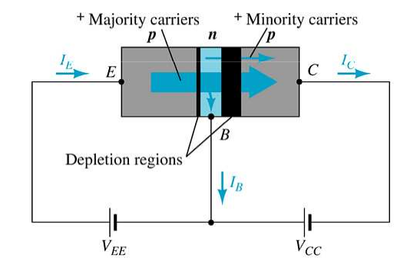





$$I_{E}=I_{C}+I_{B}$$
$$I_{C}^{′}=I_{C}^{Majority}+I_{C}^{Minority}$$
$$I_{C}^{′}=I_{C}+I_{CO}$$
I_{CO} is the reverse saturation current which is generated due to the thermal energy
Generally, I_{C} will in the order of milliamperes and I_{CO} will in the order of microamperes or nanoamperes.
$$I_{c}>>I_{b};$$
$$I_{c}≈I_{e}$$
For a typical transistor, 95% to 99% of the charge carriers from the emitter enters into the collector region

Slide 14
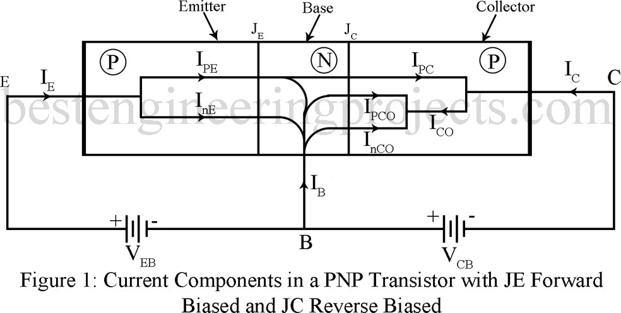
Working Mechanism & Current Components
For the P-N-P transistor, B-E junction is forward biased and C-B junction is reverse biased.
When base-emitter junction is forward
biased, due to
the concentration gradient,
carriers are injected in both side of junction.
Electrons will inject from Base towards emitter which results is current component InE.
Similarly, holes will inject from Emitter towards base region and resulting current is IpE.
So total emitter current:
IE=IpE+InE

Slide 15
Current components in BJT
After reaching base terminal, few no of holes will recombine with free electrons and lost. The resulting recombination current is base current (IB). So IB=IpE-IpC
Note, in base region due to recombination, some of the electrons are lost and those additional electrons are supplied from external bias voltage which gives base current IB.
Rest of the holes will move towards collector terminal and collected. This gives the hole current component (IpC)

Slide 16
Current component in BJT
Considering Reverse Saturation current
Assuming E-B terminal is open and C-B junction is reverse biased. Since Collector-base junction is reverse biased, there is reverse saturation current or leakage current (ICO).
Let InCO is the leakage current due to electrons moving towards base terminal. Similarly, IpCO is the leakage current due to holes moving towards collector.
Applying KCL: InCO+IpCO= - ICO
Now, total collector current including reverse saturation current is:
From KCL=> IC+IpC=ICO
IC=(ICO-IpC) = ICO- αIE where α < 1
Ref to textbook: Millman & Halkias, Section 5.2

Slide 17
BJT Configuration
When a transistor is to be connected in a circuit, one terminal is used as an input terminal, the other terminal is used as an output terminal, and the third terminal is common to the input and output.
Depending upon the input, output, and common terminals, a transistor can be connected in three configurations.
(i) Common-Base (CB) configuration
(ii) Common-Emitter (CE) configuration
(iii) Common-Collector (CC) configuration
In BJT, the output current is controlled through the input current. Thus, BJT is called as a current controlled device

Slide 18
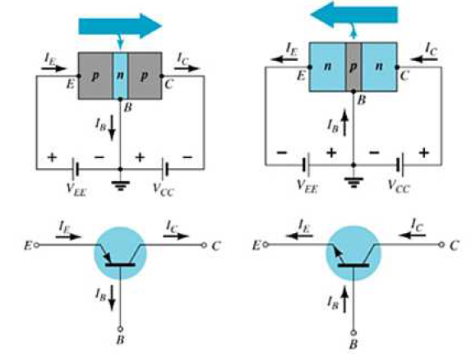
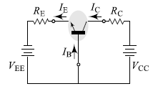
Common Base(CB) Configuration
This is also called grounded-base configuration. In this configuration, the emitter is the input terminal, the collector is the output terminal, and the base is the common terminal.
The input signal is given between emitter and base, the output is taken between collector and base.

Slide 19

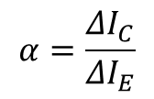


Current component in CB Configuration
$$I_{E}=I_{B}+I_{C}$$
$$I_{C}=αI_{E}+I_{CBO}$$
(Some portion of the emitter current flows to the collector region)
$I_{CBO}$= Reverse saturation or leakage current flows in base-collector junction
The reverse saturation current is very small as compared to the $αI_{E}$, it can be neglected, hence
$$α=\frac{I_{C}}{I_{E}}$$
Here, alpha is defined as the collector current divided by the emitter current. It is called as Common Base current gain or current amplification factor of CB configuration.
If the input signal is varying with time(i.e. AC signal), the current amplification factor is represented as
$$α=\frac{ΔI_{C}}{ΔI_{E}}$$
Since the collector current almost equals the emitter current, the alpha value is slightly less than 1. Its range normally, 0.95-0.99.
In this configuration power gains

Slide 20
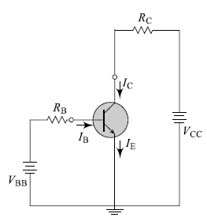
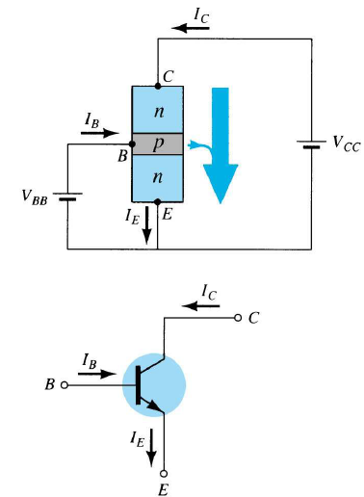
Common Emitter
In the common-emitter (CE) configuration, the emitter terminal is common to both the input and output ports.

Slide 21
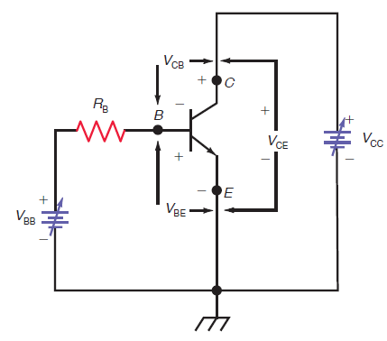

V_{BB} provides the forward bias for the base-emitter junction, and V_{CC} provides the reverse bias for the collector-base junction.
Here the base supply voltage, V_{BB}, and the collector supply voltage, V_{CC} , are variable. The base resistor, R_{B}, is used to control the amount of base current, I_{B}. With a fixed value for R_{B} , V_{BB} can be adjusted to produce the desired value of base current.
$$V_{CE}=V_{CB}+V_{BE}$$

Slide 22

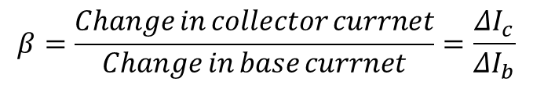
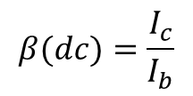
Current Component in Common emitter
$$I_{E}=I_{B}+I_{C}$$
In the CE configuration, the input and output current are related by a quantity Beta
$$β(dc)=\frac{I_{c}}{I_{b}}$$
$$β=\frac{Change in collector currnet}{Change in base currnet}=\frac{ΔI_{c}}{ΔI_{b}}$$
For AC signal, it is defined as
Beta is also called as current gain for CE configuration
For low-power transistors (under 1W), the current gain is typically 100 to 300. High-power transistors (over 1W) usually have current gains of 20 to 100.

Slide 25
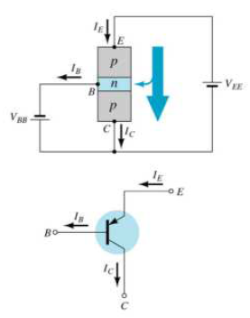
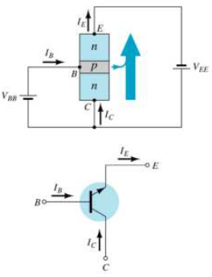
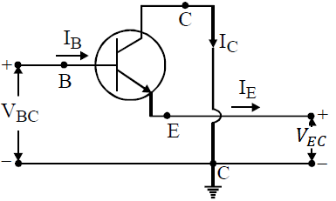
Common Collector
In the common-collector (CC) configuration, the emitter terminal is common to both the input and output ports.
The battery V_{BB} used on the input side maintains a forward bias on the BE junction and the resistor R_{B} is to limit the base current (drive). Similarly, the battery V_{CC} is used on the output side, maintains a reverse bias on the CB junction and the resistor R_{E} is used to collect the output.

Slide 26
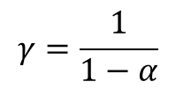






Current Amplification factor:
The ratio of output current to input current is called current amplification factor. In a common collector connection, the output current is emitter current (I_{E}), whereas the input current is base current (I_{B}).
$$γ=\frac{I_{E}}{I_{B}}$$
For an AC signal, it is defined as ratio of change in emitter current to the change in base current is represented
$$γ=\frac{ΔI_{E}}{ΔI_{B}}$$
$$I_{E}=I_{B}+I_{C}$$
$$I_{e}=βI_{b}+I_{b}$$
$$γ=\frac{1}{1−α}$$
$$γI_{b}=βI_{b}+I_{b}$$
$$γ=β+1$$

